Slide 1
Lesson 1: Introduction to Java And the Eclipse Development Environment
by Dr. Shafqat Ali Shad

Slide 2
Wholeness of the Lesson
Java is an object-oriented highly portable programming language that arose as an easy alternative to the once dominant, but error-prone, C++ language. Eclipse is one of many open source, powerful but easy-to-use integrated development environments for use with Java and related technologies. Working from deeper levels of intelligence allows one to accomplish more with fewer mistakes and less effort.

Slide 3
About Java …Cont
Brief History. The Java language began as a language for programming electronic devices, though the original project was never completed. Its creator was James Gosling, of Sun Microsystems. The language was developed privately starting in 1991, and was made publicly available in 1994. In 2009, Oracle bought the rights to Java from Sun Microsystems.
Interpreted Language. When you "compile" Java code, the result is not executable binary code, targeted to a particular machine; instead, the result is bytecode, having a portable intermediate code format. The bytecode is then executed by running an interpreter, called the Java Virtual Machine (JVM). This approach makes Java code highly portable; Java will run on any platform for which a JVM has been created.

Slide 4
About Java …Cont
JIT. Interpreters run much more slowly than native binary executable code. Java performance is boosted considerably in modern-day JVMs because of the inclusion of a just-in-time compiler; this feature compiles frequently occurring bytecode sequences into native binary code and caches the results, re-using the cache as needed. The result is that Java runs almost as fast as C++ in typical cases.
No Pointers. Compared to C++, Java is a simple language, though some feel that Java is becoming too complicated with successive releases. One of the most significant features that simplifies use compared with C and C++ is that Java does not use "pointers" – which means that the programmer is not responsible for managing memory. Memory management is handled automatically in Java by means of a garbage collector. The garbage collector is run by the JVM at different times during program execution to return to memory all unusued object references.

Slide 5
About Java
Java Is an OOP Language. Java is an OO programming language, and succeeds in this better than C++, which (for the sake of backwards compatibility with C) supports a non-OO programming style (in C++, OO programming is "optional").
Convenient Libraries. Java provides convenient libraries for handling files and streams, networking, http, gui development, and database connection. Compared to languages like C and C++, the increased ease of use is significant.
Good Security Model. Java has a relatively good security model to support use over networks and distibuted environments. Though security holes are still found sometimes, these are rare and quickly patched.

Slide 6
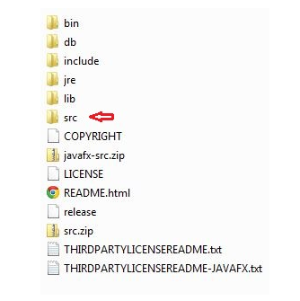
The JDK Distribution…Cont

Slide 7
The JDK Distribution
It's a good idea to unzip src.zip and place in a source folder (called “src” in the screen capture above) – this will allow you to see how Oracle has implemented its library classes. You can also unzip javafx-src.zip to look at JavaFX source code.
Oracle provides online documentation of all the Java library classes. For jdk1.8, the link is https://docs.oracle.com/javase/8/docs/api/

Slide 8
Working with the JDK… Cont
Try running code from the demo folder. TIP: If, to your PATH environment variable, you add the path to the javac compiler and to java.exe, compiling and running java programs from the console is much easier. Typical path to these executables (the first is for the 64 bit distribution, the second for the 32 bit distribution):
C:\Program Files\Java\jdk1.8.0_45\bin
C:\Program Files (x86)\Java\jdk1.8.0_45\bin

Slide 9
Working with the JDK
Create a “hello world” example by typing the following lines of code in WordPad (or Notepad), and save in a convenient location as Hello.java.
class Hello {
public static void main(String[] args) {
System.out.println("Hello World");
}
}
Then compile by typing the following command in the console:
javac Hello.java
Notice a new file Hello.class has been created. Then run it with the command
java Hello

Slide 10
Main Point
Java is an object-oriented programming language that is easier to use, less error-prone, and more portable (and nowadays, more popular) than C++. Java code is compiled to bytecode, which can then be converted to native code on a target platform, by way of a JVM interpreter. The inefficiency of an interpreter has largely been eliminated through the use of the just-in-time compiler, which compiles frequently occurring bytecode sequences to native code and caches these for further use, at runtime. Any language has the power to reveal or obscure the truth – as Maharishi says in SCI, "it is the power of speech that it can bind the boundless."

Slide 11
Integrated Development Environments
A good IDE supports compiling, running, and debugging code with tools that are integrated and typically easy to use. For a large Java project, an IDE is indispensable.
Good choices of IDE are NetBeans, IBM Rational Application Developer (formerly WebSphere Application Developer), Borland's JBuilder, JetBrains’ IntelliJ
Another excellent choice, which has become an industry standard, is the open-source IDE Eclipse, written entirely in Java. We will use Eclipse in this course.

Slide 12
The Eclipse IDE
Getting started. To use JSE 8, you need Eclipse Luna (or later); earlier versions of Eclipse do not support JSE 8.
Features of the IDE [demo]
Try creating Hello in Eclipse, and running

Slide 13
Including Unit Testing in Your Work Environment….Cont
A quick way to test your code as you develop is to run it from the main method as we have been doing
A better way that is more reusable and useful for larger-scale team development is to have a parallel test project and use JUnit

Slide 14
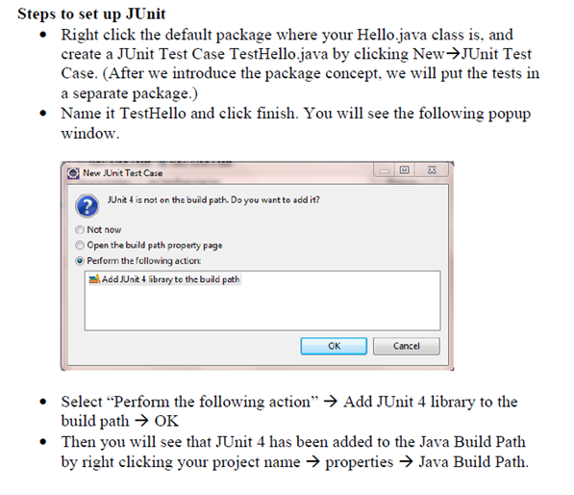
Including Unit Testing in Your Work Environment….Cont

Slide 15
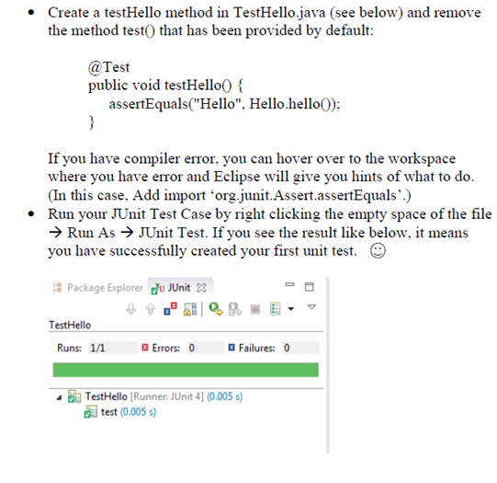
Including Unit Testing in Your Work Environment….Cont

Slide 16
Main Point
Eclipse is a leading, open-source, 100% Java, integrated development environment, which provides excellent support for editing, compiling, running, and debugging Java applications. By analogy, to create a good life, we need to handle inner life and at the same time, structure a life-supporting environment – the goal is to live 200% of life.

Slide 17
CONNECTING THE PARTS OF KNOWLEDGE WITH THE WHOLENESS OF KNOWLEDGE
From pure intelligence to Java to IDE
Using Java, highly functional applications can be built more quickly and with fewer mistakes than is typically possible using C or C++.
To optimize the use of Java's features, IDE's such as Eclipse ease the work of the developer by handling in the background many routine tasks.

Slide 18
CONNECTING THE PARTS OF KNOWLEDGE WITH THE WHOLENESS OF KNOWLEDGE
Transcendental Consciousness: To be successful, action must be based on the field of pure intelligence, which is located at the source of thought.
Wholeness moving within Itself: In Unity Consciousness, the pure intelligence located in TC is found pervading all of creation, from gross to subtle.

Slide 19
Thank you

